Slide 1

ATLIQ GRANDS HOSPITALITY ANALYSIS
Presented By
SAITHARUN K

Slide 2
INTRODUCTION
AtliQ Grands owns multiple five-star hotels across India. They have been in the hospitality industry for the past 20 years. Due to strategic movesfrom other competitors and ineffective decision-making management, AtliQ Grands are losing its market share and revenue in the luxury/business hotels category.
As a strategic move, the managing director of AtliQ Grand wanted to incorporate “Business and Data Intelligence” to regain their market share and revenue. However, they do not have an in-house data analytics team to provide them with these insights.
Their revenue management team had decided to hire a 3rd party service provider to provide them with insights from their historical data.

Slide 3
TASK TO BE ANALYSIS
Task: You are a data analyst who has been provided with sample data and a mock-up dashboard to work on the following task. You can download all relevant documents from the download section.
Create the metrics according to the metric list.
Create a dashboard according to the mock-up provided by stakeholders.
Create relevant insights that are not provided in the metric list/mock-up dashboard.

Slide 4
AtliQ
Bangalore
Delhi
Atliq Bay
Atliq Blu
Atliq City
Atliq Exotica
Atliq Grands
Atliq Palace
Mumbai
Hyderabad
Atliq Bay
Atliq Blu
Atliq City
Atliq Grands
Atliq Palace
Atliq Bay
Atliq Blu
Atliq City
Atliq Exotica
Atliq Grands
Atliq Palace
Atliq Seasons
Atliq Bay
Atliq Blu
Atliq City
Atliq Exotica
Atliq Grands
Atliq Palace

Slide 5
Dataset Details
We are provided 3 moths booking details data of all the AtliQ hotels.
Dataset contains 5 excel files.
Dim_date
Dim_hotels
Dim_rooms
Fact_aggregated_bookings
Fact_bookings
Metric list excel file
Mock-up Dashboard

Slide 6
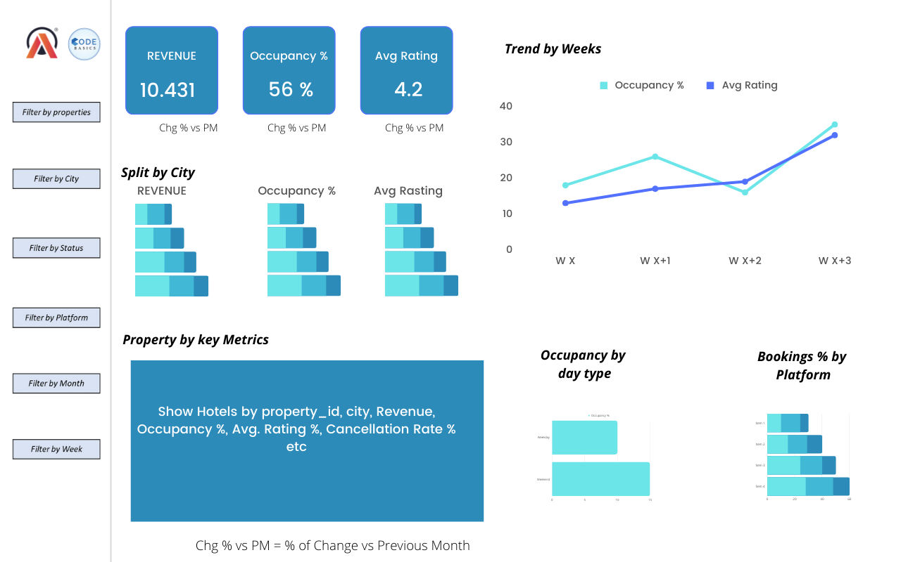
Mock-up Dashboard

Slide 7
EXPECTED OUTCOME AFTER THIS ANALYSIS ?
Regain their market share in the luxury/business hotels category.
Understanding the revenue trend by week/month/day
To get insights where business is failing and what are the best solution to tackle them

Slide 8
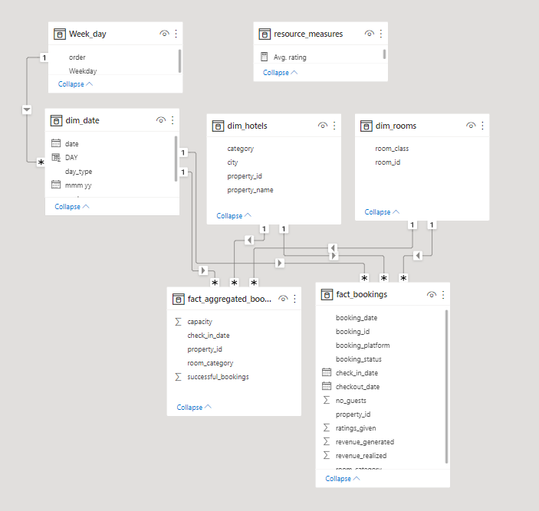
Data Model

Slide 9
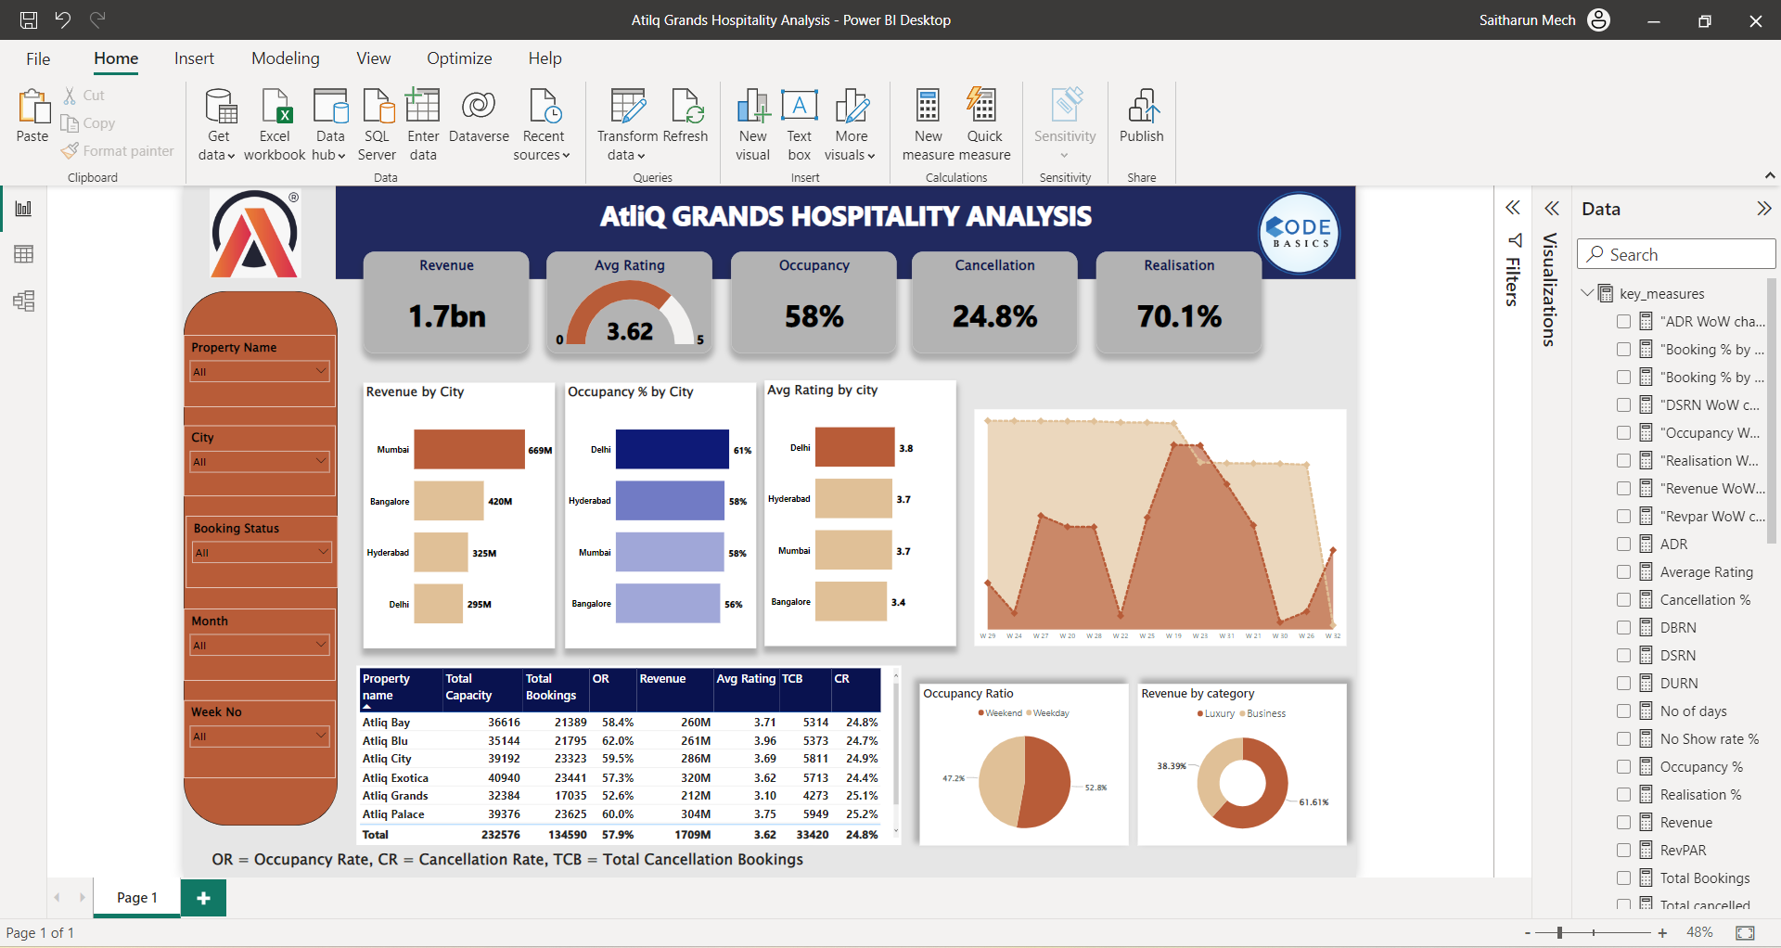

Slide 10
MY PORTFOLIO
Want to see my full interactive Dashboard, Here it is https://www.novypro.com/project/atliqgrandshospitalityanalysis
My GITHUB Profile,
https://github.com/SAITHARUN413/AtliQ_Hospitality_Analysis-Power-BI

